Slide 1

Welcome to Spiders
Class Teacher: Mr Somers
Teaching Assistants: Mrs Sauter, Mrs Martin

Slide 2
Mornings in class…
The front gate opens at 8:45am to give you access to the playground and keep you safe from queuing on the road.
Doors then open at 8.50am and close at 9.00am. Please make sure the children are prompt.
Me or the TA will be on the door to pass on messages to.
Start on a morning activity – spellings, editing work, maths games, interventions, mindfulness activity etc

Slide 3
Lunches
Your child can order their lunch in the mornings; however, we would prefer you to order and pre-pay online at home.
KS2 children need to bring their own snack for break.
All the information you need is on the website under ‘Parent Information’.
We encourage children to bring a named bottle containing water to drink every day. These will be refilled at school if needed. (We do have spare cups, if required.)

Slide 4
Behaviour
At the start of the year the class write their own charter, detailing the behaviour everyone has the responsibility to uphold.
We are having a real focus on the children being READY, RESPECTFUL and SAFE
Firm boundaries are created in a relational way to keep children happy and safe.
Any incidents are taken very seriously and often dealt with in a restorative and reparative way so that children can learn from their mistakes and repair any harm.
We follow the Positive Behaviour Policy which is on our website.

Slide 5
Curriculum coverage in Spiders
There are different units each half term that build on children’s knowledge and skills. These have been mapped out over the year to ensure full coverage of the curriculum.
Half termly topic maps are posted on our class page for you to see what is being covered.
You can support the children’s learning by giving them experiences that support the learning in class.
There are a couple of suggested home learning tasks.

Slide 6
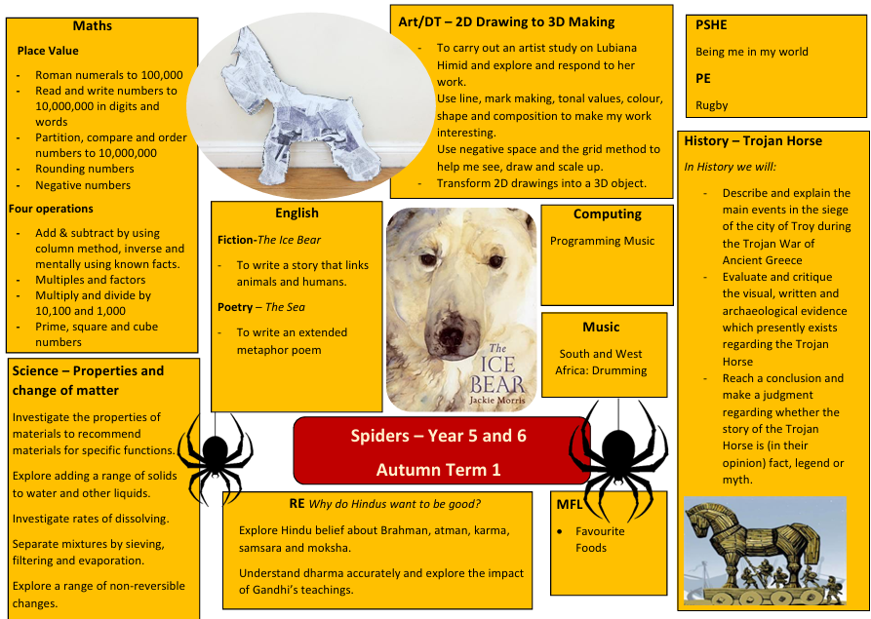

Slide 7
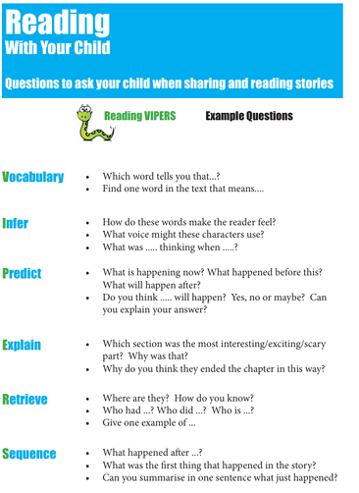
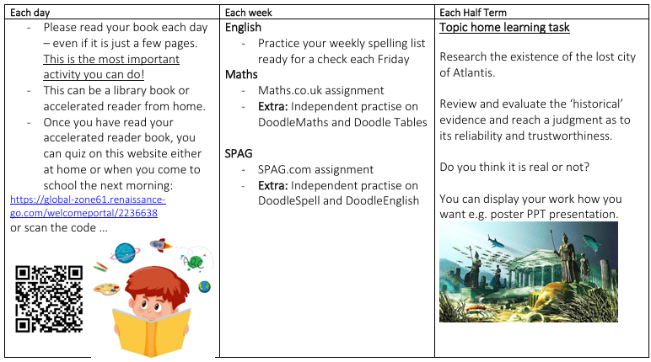

Slide 8
Reading
Your child will bring home books from school. Please listen to your children read as much as possible and ask questions to check their understanding.
Children can quiz at home or in school when they have finished their book and are responsible in picking a new book.
We use VIPERS in school to help with understanding.
The children visit the library every week. They choose books which are linked to their AR (Accelerated Reader) level as well as a ‘Reading for Pleasure’ book.
Please feel free to visit a local library or enjoy any books at home – These books are often on AR too. You can even quiz on books that the children have listened to.

Slide 9
Home Learning
Children will have weekly spellings. These will be given out at the beginning of each week, practised in class (and at home). Then, tested the following week on a Friday.
The topic map on the class page outlines the half termly home learning task.
Each week I set a short Maths.co.uk and SPAG.com assignment. These are great tools to practise and embed concepts covered in school. They might be current or historical.
Every child has a DoodleLearning log in. This is a bespoke maths, times tables, grammar and spelling app that the children can independently address gaps in their learning. They will be doing short bursts of this in school when they can but if you want something extra for them to do, 10-15mins on one of these would be great.

Slide 10
Maths
Help your child to master (and overlearn) their four operations.
Multiplication fluency is key!
DoodleMaths, Doodle Tables and TTRockstars are great to perfect their timestables and fill in gaps
Check our calculation policy on the website.
The first half-term we focus on Place Value.
Maths.co.uk homework

Slide 11
Uniform
PE for Spiders takes place on Thursday and Friday. Please make sure your child comes to school in their PE kit.
Children should avoid wearing earrings on PE days, or they need to be able to remove the earrings themselves or wear tape.
Long hair must be tied back; please ensure they have a hair band if necessary.
All uniform to be named.

Slide 12
Home time
You can enter the playground when the gate has been opened.
The children will be dismissed at 3.20pm.
We will not allow a child to go with another adult unless it has been previously arranged with us, or the office have been informed. If you have forgotten, the school will phone you to confirm.
If you wish for your child to walk home alone, please ask me for a form– we already have a list of those who have been granted permission.
If you are collecting your child, please wait until your child has indicated to me that they have seen you.

Slide 13
Mobile Phones
Children are only to bring mobile phones to school if they are walking on their own.
They are to be turned off as soon as they enter the school grounds.
They are then locked away for the day in a lockbox

Slide 14
Standard Assessment Tests (SATs)
Taken in Year 6 on Monday 10th May – Thursday 13th May.
Appropriate adjustments are made to support children with additional needs – not necessarily children on the Special Educational Needs and Disabilities (SEND) register.
Reading, Spelling/Punctuation and Grammar (SPaG), Maths Paper 1, Maths Paper 2 and Maths Paper 3.
Year 6 club is an after school club on the run up to SATs to give exposure and calm any nerves (likely to start after Christmas).
Optional SATs revision packs are sent home over Easter if you wish to use them.

Slide 15
Secondary school and Transitions
We encourage you to visit schools during school time and during organised visits.
Please take your child with you.
Transitions have vastly improved and the secondary schools seek more in-depth data and knowledge.
All secondary schools come and visit your children here, they speak to adults involved at Stoke Gabriel (Y6 teacher, SENDCO and the head) and organise transition days for children to visit their new setting (Churston, KEVICC, Paignton College and Brixham College).
Enhanced transition for those that need.

Slide 16
Keep in touch…
We are available most days after school and you can make an appointment to discuss any matters or concerns. If you prefer to email, please do.
Similarly, I will contact you if we have any concerns or queries regarding your child.
Finally, if you’d like to help out at school, you are most welcome!
You must be cleared by DBS and wear a visitor badge in school - please contact the office for details.

