Slide 1
Phonics Workshop
28.9.2026

Slide 2
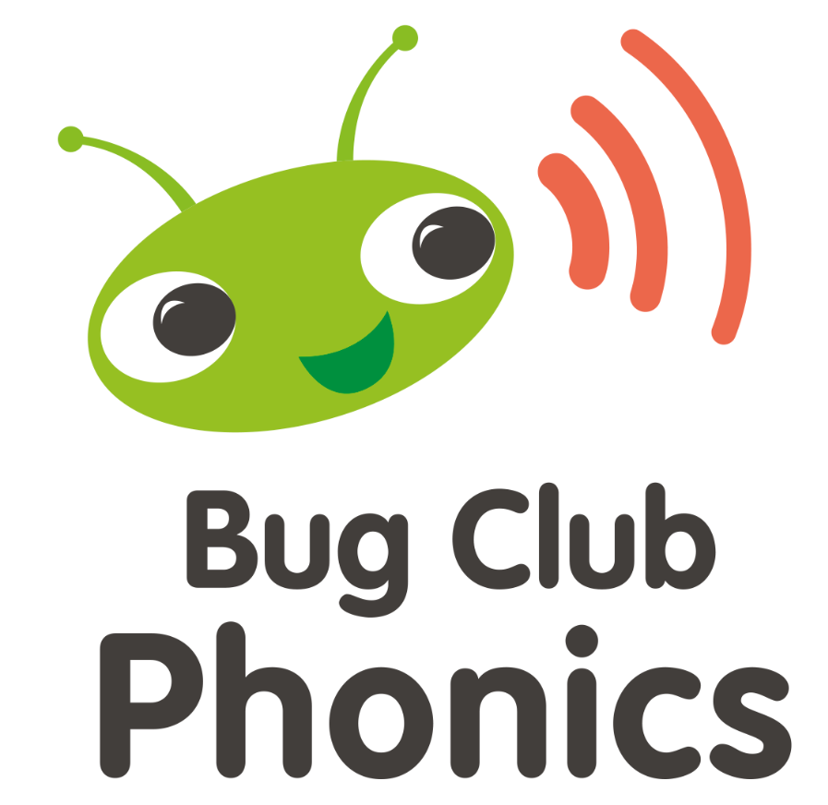
What is phonics?
Phonics is a method for teaching reading and writing.
It develops phonetic awareness – the ability to hear, recognise and use the sounds within words.
Learners are also taught the correspondence between sounds and the graphemes (spelling patterns) that represent them.
Children will also be taught other skills, such as whole-word recognition (see ‘tricky words’), book skills, comprehension and a love and enjoyment of reading.

Slide 3
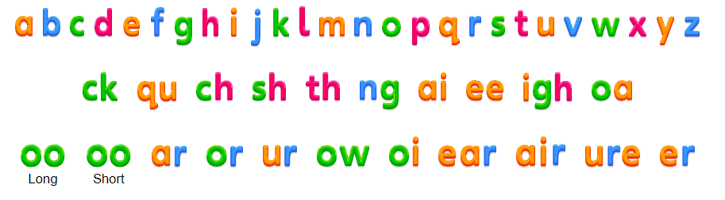
Did you know?
The English language has:
26 letters
44 sounds
over 100 ways to spell those sounds
It is one of the most complex languages to learn to read and spell.

Slide 4
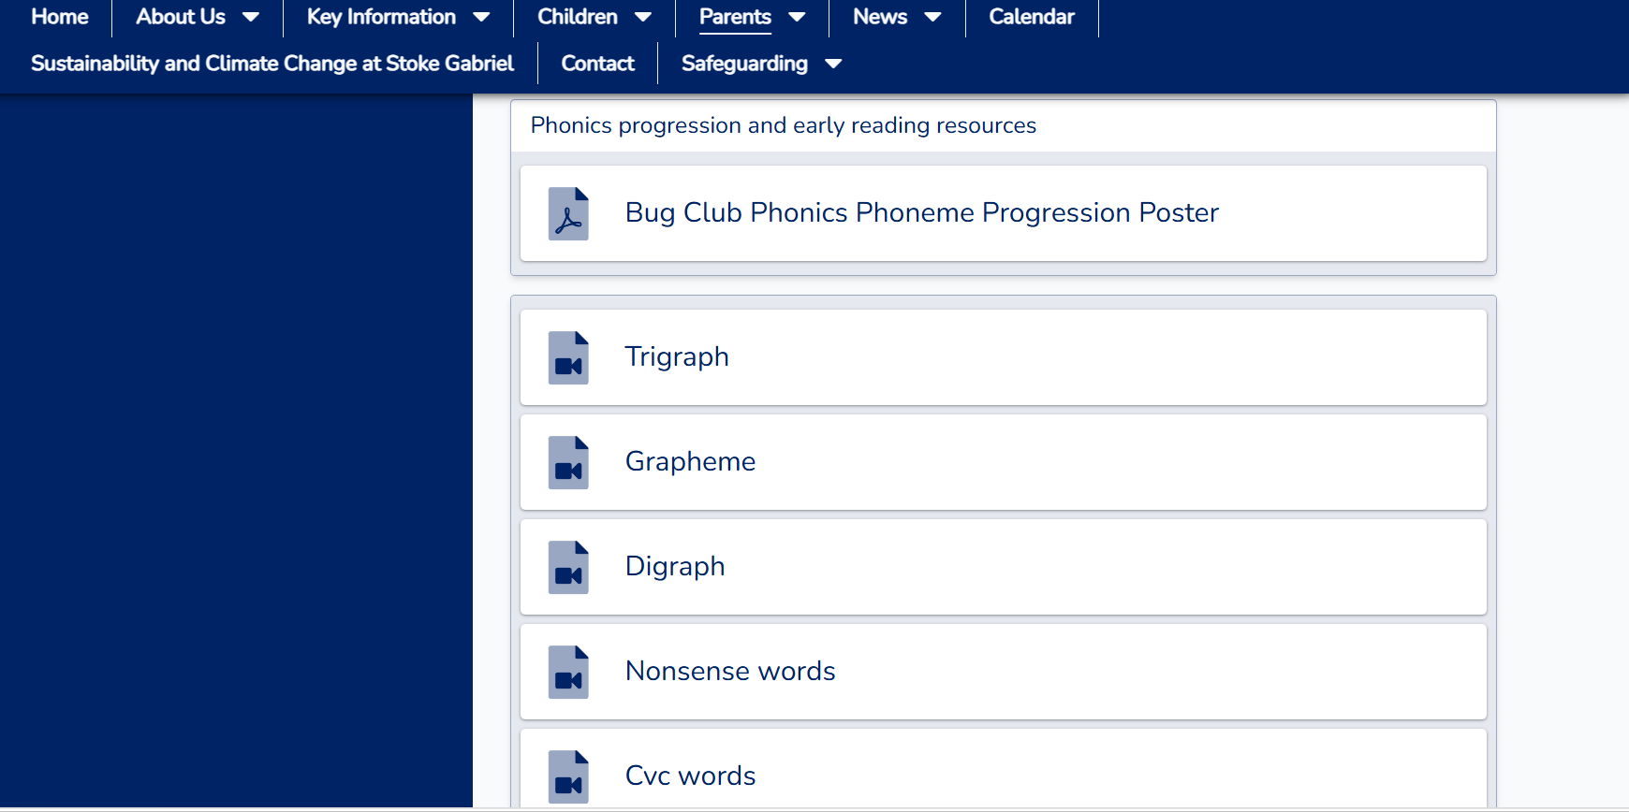
terminology
Phoneme – the smallest unit of sound to represent a letter.
Grapheme – a letter or group of letters representing one sound
Blend/Blending – to draw individual sounds together to pronounce a word e.g. s-n-a-p blends together and reads snap. Used to read words.
Segment/Segmenting – to split a word into its individual phonemes in order to spell..
Tricky words – words that are not phonetically de-codable
VC - vowel consonant words e.g. in, on, up
CVC - consonant, vowel, consonant words e.g. cat, sit, hop, zip
Comprehension – understanding the story and what they are reading
Fluency – reading without sounding out words
Stoke Gabriel Primary School - Parent Guides/ FAQ (thelink.academy)

Slide 5

Pure sounds
Pure sound in phonics is the pronunciation of each letter sound clearly and distinctly without adding additional sounds to the end (uh).
Pure sounds are a crucial part of learning phonics pronunciation. Being able to sound out pure sounds makes it much easier for children to blend sounds together to read.
Notes:
When pronouncing phonics sounds, it’s important to pronounce them phonetically without adding anything extra to the end. This is called a ‘schwa’. This is one of the most common mistakes that people make with phonics pronunciation.

Slide 6





How you can support at home
Bingo
Tricky word hunt
Splat the tricky word
Board game
Stepping stones/Puddle jumping
Notes:
Practise phonemes and tricky words

Slide 7
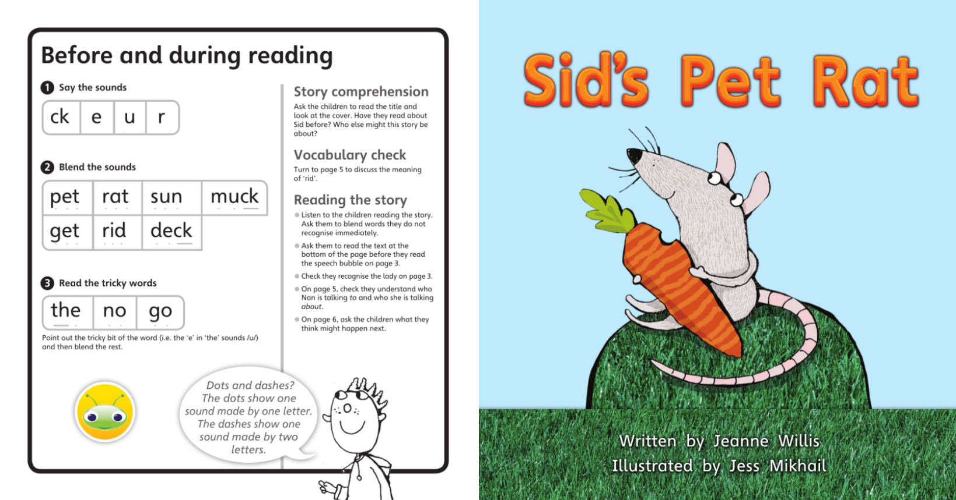
How you can support at home
Notes:
Read your child's book. Read the front cover of the book with the focus sounds, words and tricky words.

Slide 8
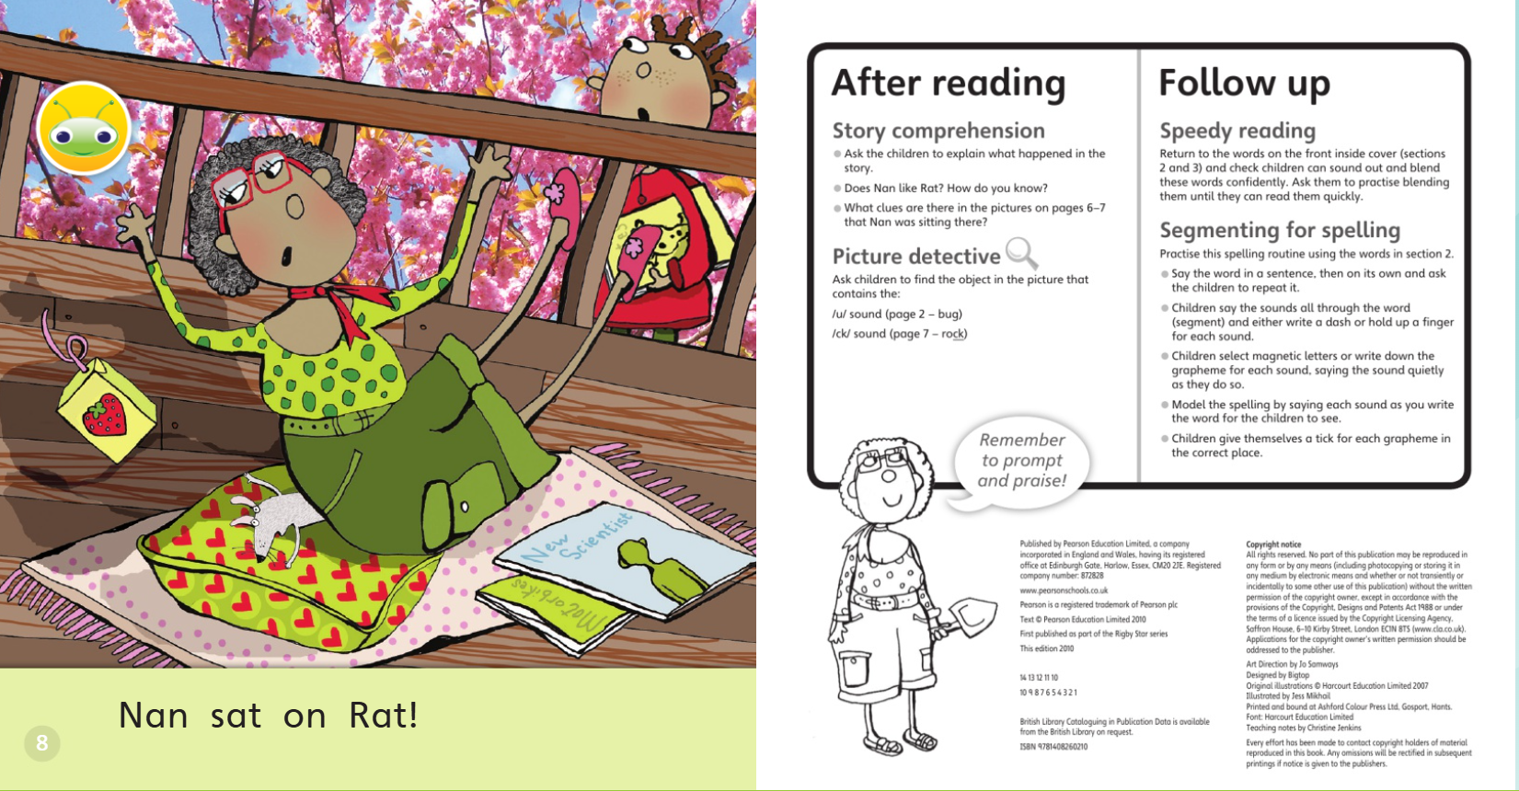
Notes:
Read and talk about the story using the questions on the back page.

Slide 9
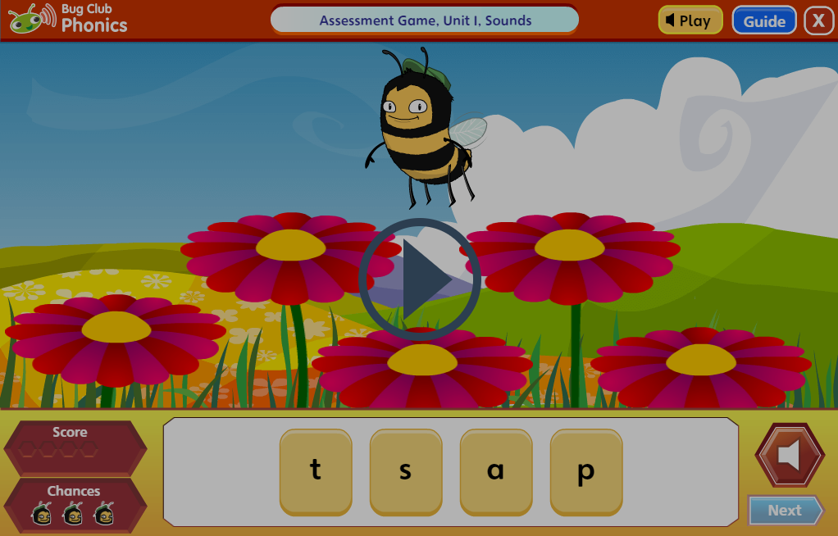
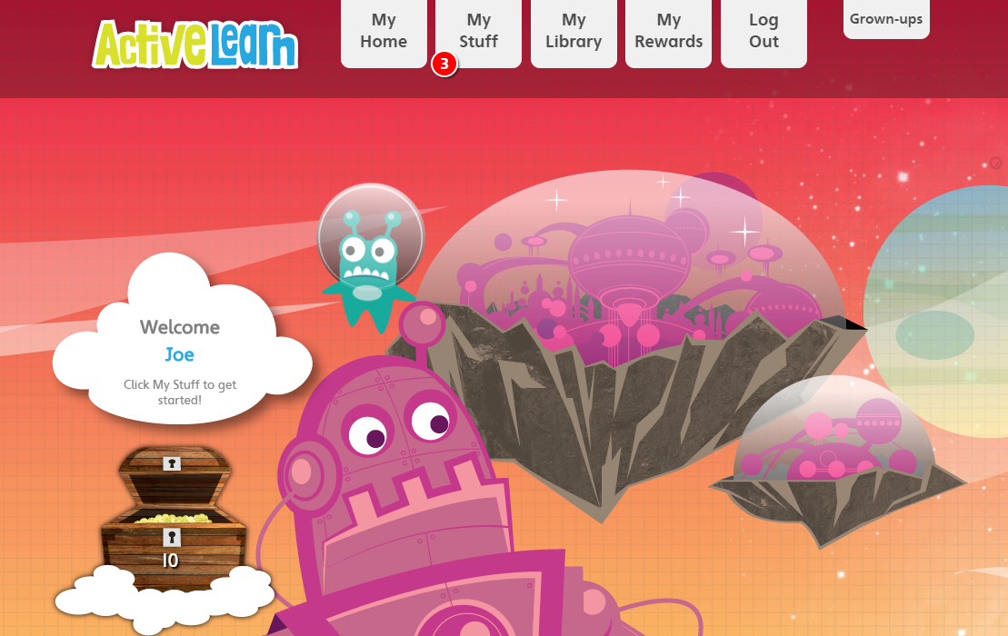
How you can support at home
ActiveLearn: Login
Notes:
Bug Club online – there are additional books and games to support your child's phonics journey.
Children have a log in which is stuck in the front cover of their reading record.
There is also a link to the bug club website on Tapestry.

Slide 10
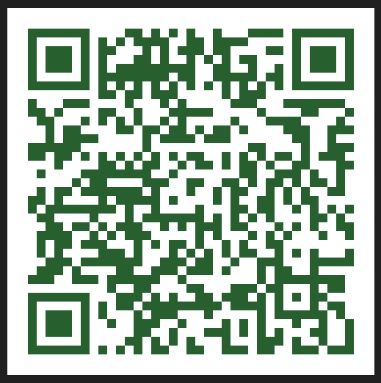
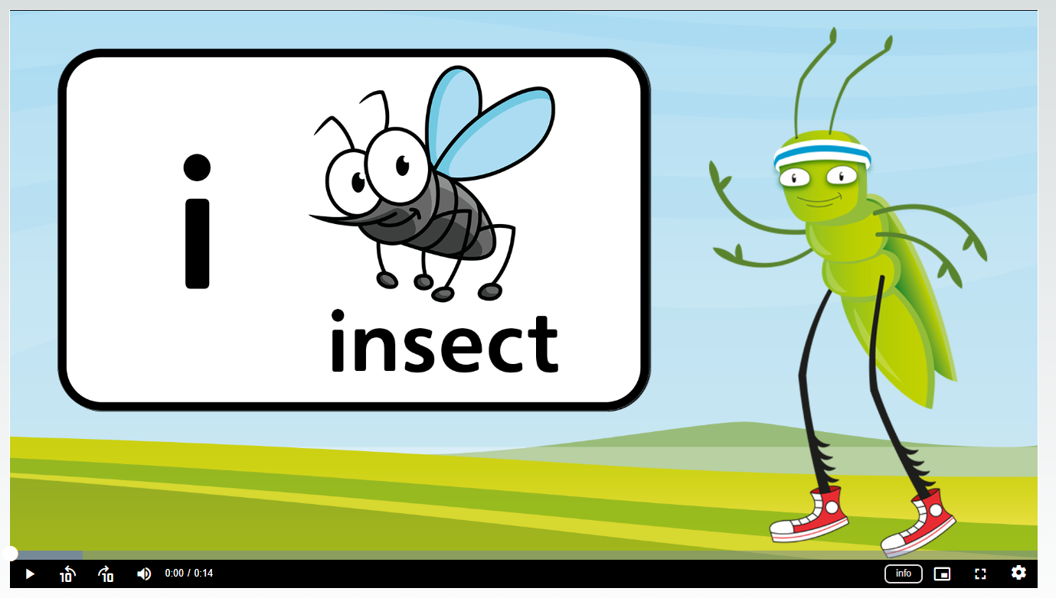
How you can support at home
Notes:
QR codes on tapestry which link to a bug club video showing you how to pronounce the sound and the picture/action that goes with that sound.
These will be added at the end of each week with the sounds children have learnt that week.

Slide 11

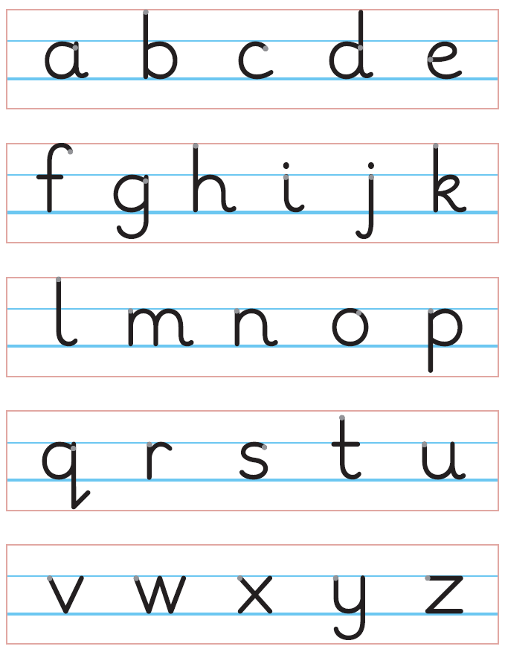
How you can support at home
Notes:
Letter formation – important that the children learn the correct way to form each letter. This a foundational skill that develops muscle memory.

