Slide 1
Welcome to Ladybirds and Dragonflies class

Slide 2
Mornings
The front gate will open from 8:45 a.m to give you access to the playground.
Doors open at 8.50am which is the start of the registration time. Please make sure the children arrive promptly.
Miss Gaskin or Mrs Smith will be on the door to pass on messages to.
Children should enter the school independently.
Children complete their morning checklist. Children will hang their belongings on their peg, put their water bottles in the basket, place their book bag in their tray and check their lunch with a member of staff. They will then start a morning activity straight away.

Slide 3
Lunches
All EYFS and KS1 children are entitled to a free school meal. Please order these online at home via Bromcom. However, if you forget children can order their lunch in the morning.
Children will have fruit and vegetables available as their morning snack at school. If you want to bring in your own then make sure it is a healthy snack. Reception children also access to daily milk.
All the information you need is on the website under ‘Parents'.
We ask that all children bring a named bottle containing water to drink every day. These will be refilled at school if needed.
Notes:
Recommend ordering lunches at home as if left for children to do they will often just choose a sandwich!

Slide 4
Behaviour
Class charter. At the start of the year the class write their own class charter, detailing the behaviour everyone has the responsibility to uphold.
We use a relational approach were building relationships and ensuring safety are key.
Clear boundaries are created to keep children happy and safe.
Any incidents are taken very seriously and often dealt with in a restorative and reparative way so that children can learn from their mistakes and repair any harm.
We are ready, respectful and safe.

Slide 5
Our Curriculum
There are different units each half term that build on children’s knowledge and skills. These have been mapped out over two years to ensure full coverage of the curriculum and a development of knowledge and skills during their time in this class.
Half termly topic maps are posted on our class webpage for you to see what is being covered. These have also been emailed to you.
You can support the children’s learning by giving them experiences that support the learning in class.
There are a couple of suggested home learning tasks.

Slide 6

Bug Club
Children are taught phonics, spelling and handwriting through the scheme.
Phonics is all about sounds which we put together to form words.
Children are taught a new sound everyday in Reception and Year 1.
Children on the Bug Club scheme will take home a book based on their sound knowledge and confidence.
I will hold a Phonics Workshop on Monday 28th September for more information on Phonics.

Slide 7

Reading at home
Please read their assigned Bug Club book with them and practise the words and sounds at the start of the book and the comprehension questions at the end.
Please record when you have read with your child at home in the yellow reading record.
Notes on words they found hard to read or needed help to understand, or an idea of the discussions are always helpful.
Normally, we ask children to read their phonics book 3 times. This is the amount needed to show the necessary fluency (this may be more/less).
Feel free to include library books the child has read or bedtime books you have shared together.
The children will have the opportunity to choose a book from the library every week. This will be on a Friday. Please make sure the children bring their library book in on a Friday to change it.
Please make sure children have their Bug Club book and reading record in school every day.

Slide 8
Reading Journey
Children at school will practise reading skills through Bug Club, guided reading sessions and English lessons.
Once the children have finished Bug Club phonics scheme, they will work through the ‘reading for fluency’ bug club books. There is a range of colours, with the final colour being lime.
After this, reading will be assessed on Accelerated Reader and they will take home an AR book based on their reading age. The children independently quiz on these to test their comprehension. These books may be a bit longer and the children are encouraged to change these with developing independence. Please remind and encourage them to read often and quiz when they complete the books.
Notes:
Reading for fluency books – Year 2
AR – Year 2/3

Slide 9
Home Learning
Read, read, read!
As children are introduced to new phonemes, they will be added to their phonics book for you to practise at home. Please see the parent table on our website for support guides!
Half termly topic maps are posted on our class page for you to see what is being covered.
On the topic map on the class page you can find some optional home learning.
Any extra home learning done that is linked to our topics will always be celebrated.

Slide 10
Maths
By the end of Reception children will have a deep understanding of numbers to 10, be able to recall number bonds and recall some number facts such as doubles. They should be able to count verbally to 20 and recognise the pattern of the counting system.
By the end of Year One the children are expected to count to 100 forwards and backwards, recall addition and subtraction facts to 20 and count in 2s, 5s and 10s.
By the end of Year Two children are expected to count forward and backward in steps of 2, 3 and 5 from 0 and in 10s from any number..
Have a look at the calculation policy on the school website to see the different stages of addition and subtraction.
All children have a login for Numbots which is a maths games they can play at home. This can be found in their reading record.

Slide 11

Tapestry
We will observe and record learning for the children in Reception on Tapestry.
Parents of children in Reception will have a Tapestry login.
Comments on observations are a great way to engage in your child’s learning.
Please add any WOW moments, trips out, activities at the weekend for us to share with the class.

Slide 12
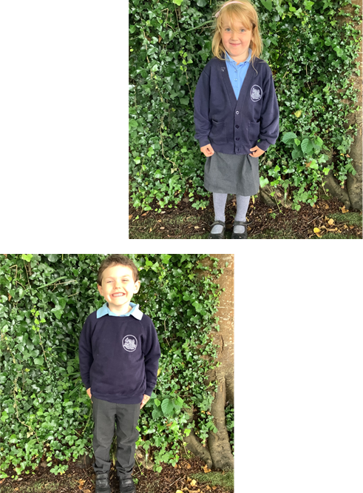
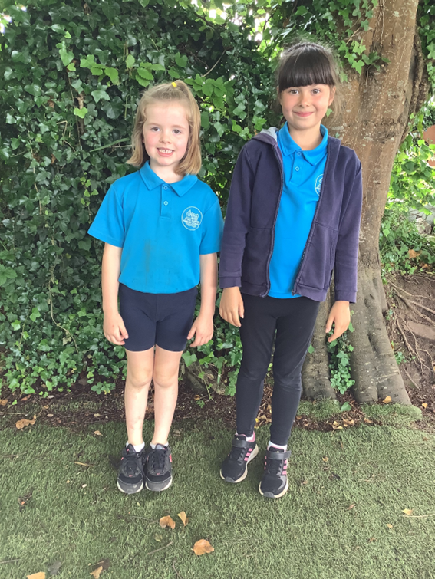
PE and Uniform
PE for Ladybirds and Dragonflies takes place on Wednesdays and Thursdays. Please make sure your child comes to school in their PE kit.
We recommend children wear trainers on PE days to better support their feet.
Long hair must be tied back, please ensure they have a hair band if necessary.
All uniform to be named.

Slide 13
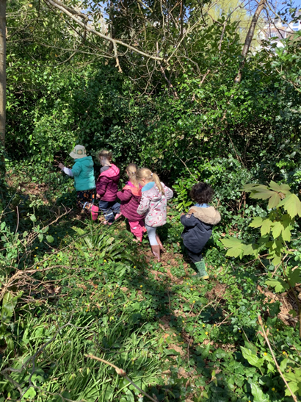
Outdoor Learning
Children in Ladybirds will take part in Outdoor Learning on the field.
Children will need to wear long sleeves, trousers and plenty of layers to keep them warm (during the winter).
Please bring in waterproofs, wellies, a change of clothes and hat/gloves (depending on the weather)
Children in Dragonflies will join outdoor learning once a month and will need to bring the appropriate clothing on these days.
This term the children will be taking part in Outdoor learning on Tuesday 15th September and Tuesday 20th October.

Slide 14
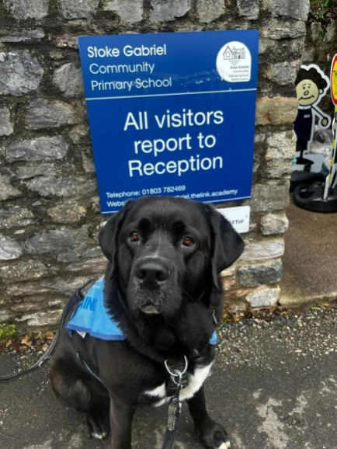
Home time
You can enter the playground when the gate has been opened.
The children will be dismissed at 3.20pm.
We will not allow a child to go with another adult unless it has been previously arranged with us, or the office have been informed. If you have forgotten, the school will phone you to confirm.
Please ensure you call the office regarding any changes of arrangements before 1 p.m. The answerphone will be checked at 3 p.m.
Please note that there are to be no dogs on the playground other than our school dog, Moose.

Slide 15
Extra information
Prescribed medicines are only administered with parental consent. Forms at the office.
Moose is now an established part of our school team and comes in most days.
Please ensure all emergency contact details are up to date.
Assessments in the Early Years
  Reception Baseline Assessment
  The EYFS Profile (EYFSP) at the end of Reception. Children will be assessed as Emerging or Expected in all 17 areas of learning.
End of Key Stage assessments
  Year 1 – Phonics screening beginning of June
Website and school Facebook will be updated regularly.

Slide 16
Please come and talk to me
Mornings are always busy.
I’m available most days after school and can make an appointment with you to discuss any matters or concerns.
Similarly, I will contact you if we have any concerns or queries regarding your child.
Finally, if you’d like to help out at school then we welcome help in our library and on trips. Please speak to Ms Eeles.

Slide 17
Any questions?

