Slide 1

Welcome to Butterflies
class

Slide 2
Staff
Mr Arts - Monday, Tuesday
Mrs Peace- Wednesday, Thursday, Friday
Each day, we will be supported by Mrs Sautor (Mrs S), our wonderful TA. AM/PM

Slide 3
Mornings
Doors open at 8.50am and close at 9.00am.
Children come in to complete their morning challenge – times tables & spelling / reading

Slide 4
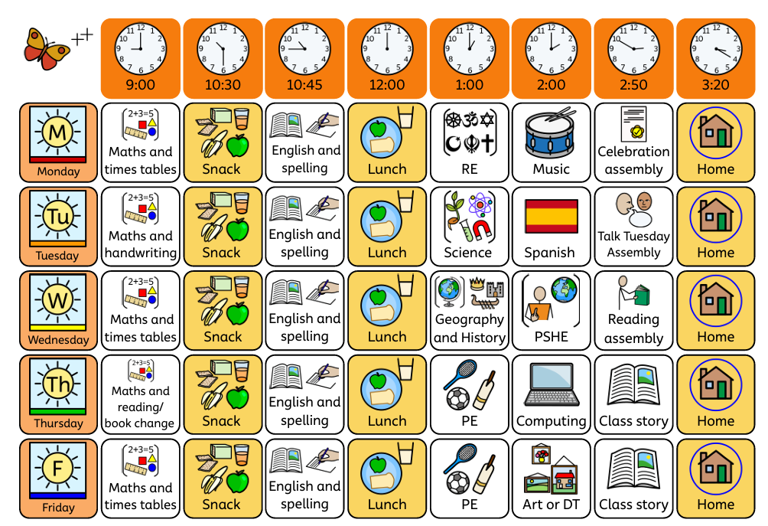

Slide 5
Behaviour
At the start of the year the class write their own charter, detailing the behaviour everyone has the responsibility to uphold.
We have a relational approach to behaviour where building relationships and ensuring safety are key.
Firm boundaries are created to keep children happy and safe.
Any incidents are taken very seriously and often dealt with in a restorative and reparative way so that children can learn from their mistakes and repair any harm.

Slide 6
Our Curriculum
There are different units each half term that build on children’s knowledge and skills. These have been mapped out over the year to ensure full coverage of the curriculum.
Half termly topic maps are posted on our class page for you to see what is being covered and a paper copy will be sent home.
You can support the children’s learning by giving them experiences that support the learning in class.
There are a couple of suggested home learning tasks each half term.

Slide 7
Reading at home/ Bug Club
Children will have a reading record in Butterflies. Either they can fill in what they have read if read independently or you can add comments if they have read aloud to you.
The aim is 5 reads a week – ‘Reading for Pleasure is the single most important indicator of a child’s future success’.
Please make sure the children’s books and reading records are in school every day so that we can monitor the amount they are reading and read with them.
AR quizzes can be done in class and at home. (QR code is on learning overview of the half term).
https://login.renaissance.com/12d2caef-cae3-45c9-a40c-164dbe670f66?state=172f61dd-e81c-46dd-ac64-bf73efef4fd7

Slide 8
Home Learning
Read, read, read
The topic map on the class page will always have a suggested task that the children can do to extend the learning that they have done in class.
Any extra home learning done that is linked to our topics will always be celebrated!
Times tables practice
Spelling practice – spelling check on Friday to see who needs extra support with particular spellings.

Slide 9
P.E & Uniform
PE for Butterflies takes place on Thursday afternoons with Mr Tanner and Fridays with Mrs Peace. Please make sure your child comes to school in their PE kit.

Slide 10
Home time
We will not allow a child to go with another adult unless it has been previously arranged with us, or the office have been informed. If you have forgotten, the school will phone you to confirm.
If this is a regular arrangement, please let me know.

Slide 11
Extra info
Please do not allow your child to bring in toys.
Please ensure all emergency contact details are up to date.

Slide 12
Please come and talk to us
We are available most days after school and can make an appointment with you to discuss any matters or concerns.
Parents evening will be just before October half term – settling in.

Slide 13
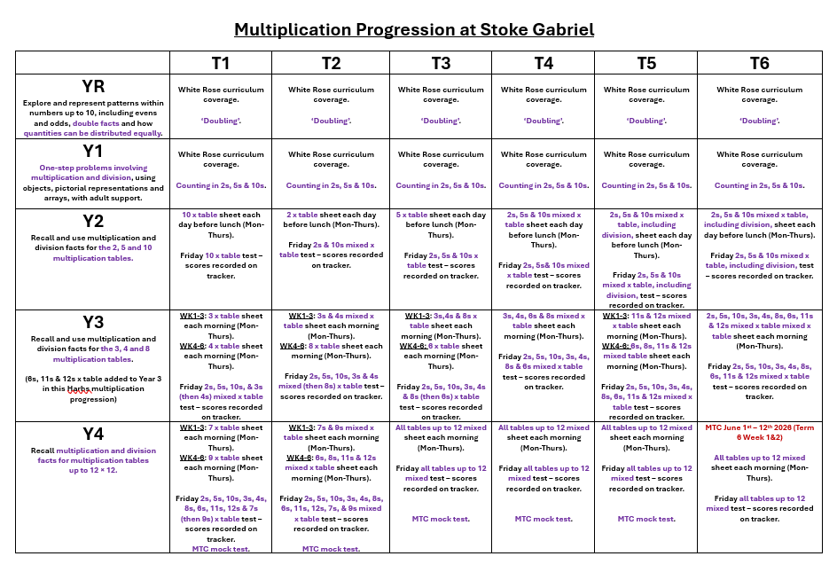

Slide 14
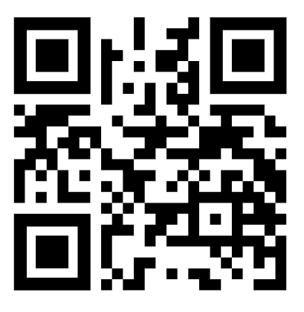
Times Tables
Year 4s have a multiplication check in June. (MTC)
They will need to recall times tables fluently up to 12 x12, through a set of 25 timed questions. The children have 6 seconds to answer each question.
Helpful websites – Times table rock stars
‘Urbrainy’ - https://urbrainy.com/mtc

