Slide 1
Welcome to Bumblebees Class

Slide 2
Mornings
The front gate will open from 8:45 a.m to give you access to the playground.
Doors open at 8.50am which is the start of the registration time. Please make sure the children arrive promptly.
A member of the Pre-School team will be at the yellow gate to welcome the children and you can pass on any messages to them.
Children will hang their belongings on their peg, put their water bottles in the basket and play until group time.
At 9 a.m. we gather and sing the ‘Hello’ song, count the children, check lunches and then the children will place their name on the ‘Who is here today?’ board.

Slide 3
Learning
The children learn through play.
Each area is set up with activities that cover the seven areas of learning:
These are C+L, PSED, PD, Maths, Literacy, UTW and EAD
For a large part of the day the children are able to free flow around our space so please provide coats, hats, suncream etc
This also means that the outside door is open, please send children with lots of layers.
Wellies and waterproofs are encouraged as we will be outside in ALL weathers.

Slide 4
Lunches
Please order school lunches online at home via Bromcom. However, if you forget children can order their lunch in the morning. If providing a packed lunch please remember we are a nut free setting.
Children will have fruit and vegetables available as their morning snack at Pre-School. This served buffet style to encourage independence and healthy choices. Children also access to daily milk.
We ask that all children bring a named bottle containing water to drink every day. These will be refilled if needed.
We eat lunch in our class room.

Slide 5
Toileting
We will support your child on their toileting journey.
We ask that you provide nappies and wipes in your child’s bag.
There is a changing area in the staff toilets.
Intimate care forms will be filled in after each nappy change and we will ask you to sign these at the end of each session.
Potty training. When the time comes to potty train your child we will support you and we have a range of potties, toilet seats and steps. We just ask that you provide plenty of spare clothes and send them wearing trousers that are easy to pull up and down.
Once children are fully independent,they will use the children’s toilets.

Slide 6
Behaviour
We use a relational approach, building relationships and ensuring safety are key.
Clear boundaries are created to keep children happy and safe.
We use lots of positive reinforcement and praise.
We are ready, respectful and safe.

Slide 7

Bug Club
Children are taught phonics, spelling and handwriting through the scheme.
Phonics is all about sounds which we put together to form words.
In Pre-School we focus on phase 1. This is learning to listen and differentiate between sounds.

Slide 8

Tapestry
We will observe and record learning for the children on Tapestry.
Parents will have a Tapestry login.
Comments on observations are a great way to engage in your child’s learning.
Please add any WOW moments, trips out, activities at the weekend for us to share with the class.

Slide 9
PE and Uniform
The Bumblebees children that will be going into Reception the following September will join Ladybirds class for P.E on a Thursday. Please make sure your child comes to school in appropriate clothing.
We recommend children wear trainers on PE days to better support their feet.
We do not wear a uniform however, we do ask that your child is dressed appropriately for the weather and in clothing that is easy to move in.
We also ask that your child has plenty of spare clothes in their bag as we do get very messy!
As mentioned earlier in the wetter months we do ask for wellies and a waterproof to be provided.

Slide 10
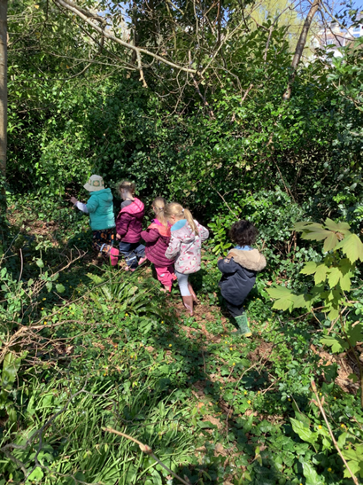
Outdoor Learning
Children that attend on a Tuesday will take part in Outdoor Learning on the field.
Children will need to wear long sleeves, trousers and plenty of layers to keep them warm (during the winter).
Children will need a packed lunch as we do not return to school until the end of the day.
Please bring in waterproofs, wellies, a change of clothes and hat/gloves (depending on the weather)
Children in Ladybirds join every afternoon and children in Dragonflies will join outdoor learning once a month.

Slide 11
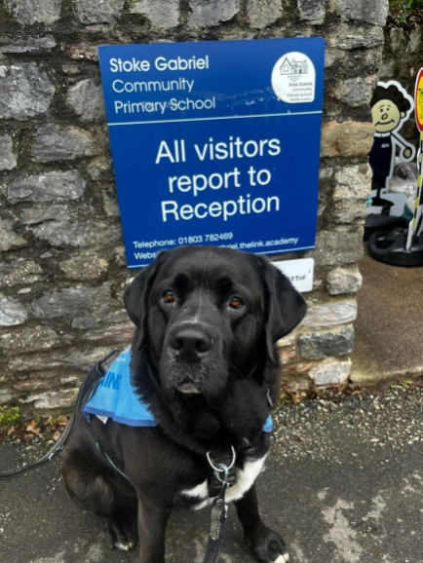
Home time
You can enter the playground when the gate has been opened.
You will be asked to sign any forms from the day.
The children will be dismissed at 3.20pm from the yellow gate by a member of the Pre-school team.
We will not allow a child to go with another adult unless it has been previously arranged with us, or the office have been informed. If you have forgotten, the school will phone you to confirm.
Please ensure you call the office regarding any changes of arrangements before 1 p.m. The answerphone will be checked at 3 p.m.
Please note that there are to be no dogs on the playground other than our school dog, Moose.

Slide 12
Extra information
Prescribed medicines are only administered with parental consent. Forms at the office.
Moose is now an established part of our school team and comes in most days.
Please ensure all emergency contact details are up to date.

Slide 13
Please come and talk to me
Mornings are always busy.
I’m available most days after school and can make an appointment with you to discuss any matters or concerns.
Similarly, I will contact you if we have any concerns or queries regarding your child.

Slide 14
Any questions?

