Slide 1
Welcome to Butterflies class
Mrs Ansermoz (Monday, Tuesday, Wednesday morning)
Miss Middlebrook(Wednesday afternoon, Thursday and Friday)
Miss Giffard

Slide 2
Mornings
The side KS2 gate and classroom doors open at 8.50 a.m and close at 9.00am. Please make sure the children are prompt.
The class teacher or the TA will be on the door to pass on messages to.
Children should enter the classrooms independently.
Morning checklist - Children will hang their belongings on their peg, put their water bottles in the crate and order their lunch with the register. They can then start on a morning activity or reading straight away.

Slide 3
Lunches
Your child can order their lunch in the mornings, however we would prefer you to order online at home so that we can minimise food waste and ensure there is no debt on ParentPay.
KS2 children need to bring their own healthy snack for break. We discourage high sugar snacks and we are a nut free school.
All the information you need is on the website under ‘Parents'.
Stoke Gabriel Primary School - Parent Guides/ FAQ
Children should bring a named bottle containing water to drink every day. These will be refilled at school as needed.

Slide 4
Behaviour
At the start of the year the class write their own charter, detailing the behaviour everyone has the responsibility to uphold.
We are taking on a relational approach where building relationships and ensuring safety are key.
We are having a real focus on the children being READY, RESPECTFUL and SAFE.
Any incidents are taken very seriously and often dealt with in a restorative and reparative way so that children can learn from mistakes and repair any harm.
We follow the Positive Behaviour Policy which is on our website.

Slide 5
Our Curriculum
There are different units each half term that build on children’s knowledge and skills. These have been mapped out over the year to ensure full coverage of the curriculum.
Half termly topic maps are posted on our class page for you to see what is being covered.
You can support the children’s learning by giving them experiences that support the learning in class.
There are a couple of suggested home learning tasks.

Slide 6
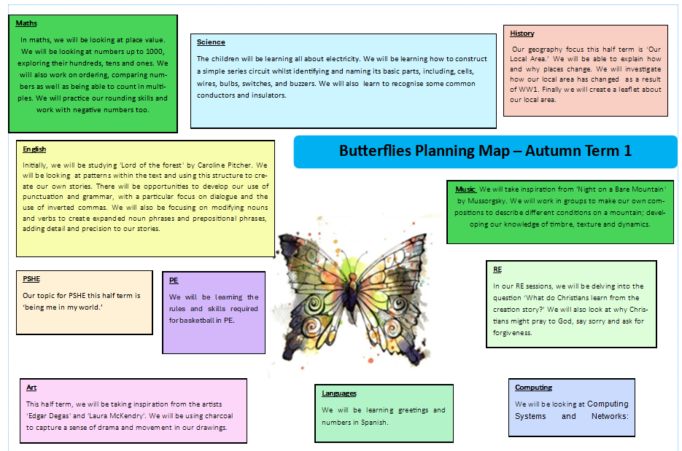

Slide 7
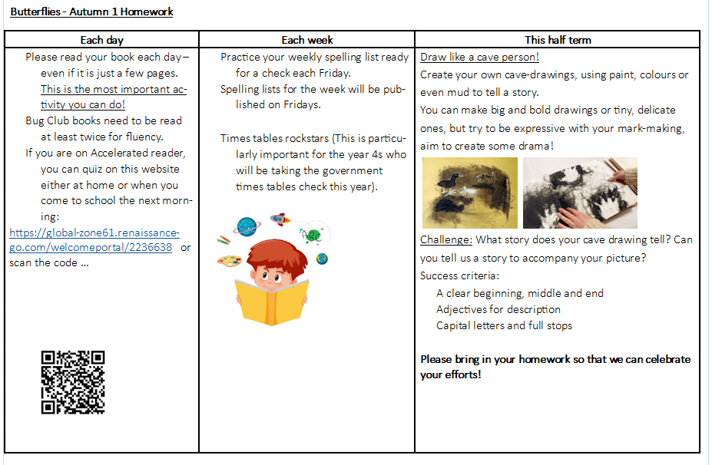

Slide 8
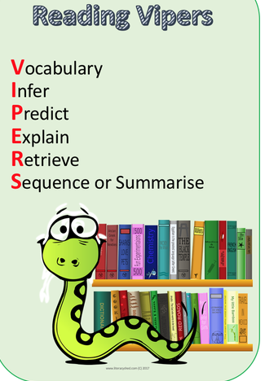
Reading at home
Your child will bring home books from school. Please read with your child and ask questions to check understanding.
Children can quiz at home or in school when they have finished their book and are responsible in picking a new book.
We use VIPERS in school to help with understanding.
The children visit the library every week. They choose books which are linked to their AR (Accelerated Reader) level or Bug Club level.
If your child has a set ‘Bug Club’ book. Please read and re-read this book with your child at home to build fluency. (This doesn’t mean that you shouldn’t read other books)

Slide 9
Reading at school
Children at school will practise reading skills through Bug Club, guided reading sessions and English lessons.
Children on the Bug Club scheme will take home a book based on their sound knowledge and confidence.
Once the children have finished Bug Club phonics scheme, they will work through the brand new ‘reading for fluency’ bug club books. There is a range of colours, with the final colour being lime.
After this, reading will be assessed on Accelerated Reader and they will take home an AR book based on their reading age. The children independently quiz on these to test their comprehension. These books may be a bit longer and the children are encouraged to change these independently. Please remind and encourage them.

Slide 10
Bug Club
Children are taught phonics and spelling through the scheme.
Please read their assigned book with them and practise the words and sounds at the start of the book and the comprehension questions at the end.
Normally, 3 reads is the amount needed to show the necessary fluency (this may be more/less).
Please make sure children have their Bug Club book in school every day.

Slide 11
Home Learning
Read, read, read!
They will have weekly spellings. These will be given out each week on paper, practised in class and at home then tested the following week. Usually we will test on a Friday.
The topic map on the class page has some optional home learning.
Any extra home learning done that is linked to our topics will always be celebrated!

Slide 12
Maths
By then end of Year Three the children should know the 3, 4 and 8 times as well as the 2, 5 and 10 times tables learnt in KS1. By the end of Year Four they will be able to recite all times tables.
TTRockstars and Numbots are a great tool to perfect their times tables.
Have a look at the calculation policy on the school website to see the different stages of addition and subtraction.
This first half term we will be focusing on place value.

Slide 13
P.E & Uniform
PE for Butterflies takes place on Thursday and Friday afternoons. Please make sure your child comes to school in their PE kit.
Children should not wear earrings on PE days, or they need to be able to remove the earrings themselves or wear tape.
Long hair must be tied back (every day!) , please ensure they have a hair band if necessary.
All uniform to be named.
On rainy days it is useful to bring a spare pair of trainers.

Slide 14
Home time
You can enter the playground when the gate has been opened.
The children will be dismissed at 3.20pm.
We will not allow a child to go with another adult unless it has been previously arranged with us, or the office have been informed. If you have forgotten, the school will phone you to confirm. Please inform us of changes by 1:30 p.m. The office is unmanned during the afternoon although we will check for messages at around 3 p.m.
If there is a regular arrangement, please let us know.
Please wait until your child has indicated that they have seen you.

Slide 15
Please come and talk to me
I’m available most days after school and can make an appointment with you to discuss any matters or concerns.
Similarly, I will contact you if we have any concerns or queries regarding your child.
Finally, if you’d like to help out at school, you are welcome!​ You must be cleared by DBS and wear a visitor badge in school - please contact the office for details. We often need library and school trip helpers!

Slide 16
Extra info
Prescribed medicines are only administered with parental consent. Forms can be found on our website or collected from the office.
Please do not allow your child to bring in toys.
Please ensure all emergency contact details are up to date.
Year 4- Times Tables Check is in June
Website and school Facebook will be updated regularly.

Slide 17
Any questions?

