Slide 1


Welcome to Class Butterflies
2024-2025
Miss McLeod – Class Teacher
Mrs Smith-Wiederkehr – Teaching Assistant (mornings)
Natalie Peakman – Teaching Assistant (afternoons)

Slide 2
Mornings
The front gate opens at 8:45am to give you access to the playground and keep you safe from queuing on the road.
Doors then open at 8.50am and close at 9.00am. Please make sure pupils are prompt.
You are welcome to enter the back playground. Myself or the TA will be on the door for you to pass messages on to.
Children should enter the school independently (where possible).
Morning Checklist - Children hang their belongings on their peg, put their water bottles in the basket and order their lunch with the register.
Start on a morning activity or reading straight away.

Slide 3
Lunches
Your child can order their lunch in the mornings, however we would prefer you to order online at home.
KS2 children need to bring their own snack for break.
All the information you need is on the website under ‘Parent Information’.
We encourage children to bring a named bottle containing water to drink every day. These will be refilled at school if needed.

Slide 4
Behaviour
At the start of the year the class write their own charter, detailing the behaviour everyone has the responsibility to uphold.
We are taking on a relational approach, where building relationships and ensuring safety are key.
Firm boundaries are created to keep children happy and safe.
Any incidents are taken very seriously and often dealt with in a restorative and reparative way so that children can learn from their mistakes and repair any harm.

Slide 5
Our Curriculum
There are different units each half term that build on children’s knowledge and skills. These have been mapped out over the year to ensure full coverage of the curriculum.
Half termly topic maps are posted on our class page for you to see what is being covered.
This is where you will find the termly homework details.
You can support the children’s learning by giving them experiences that support the learning in class.

Slide 6
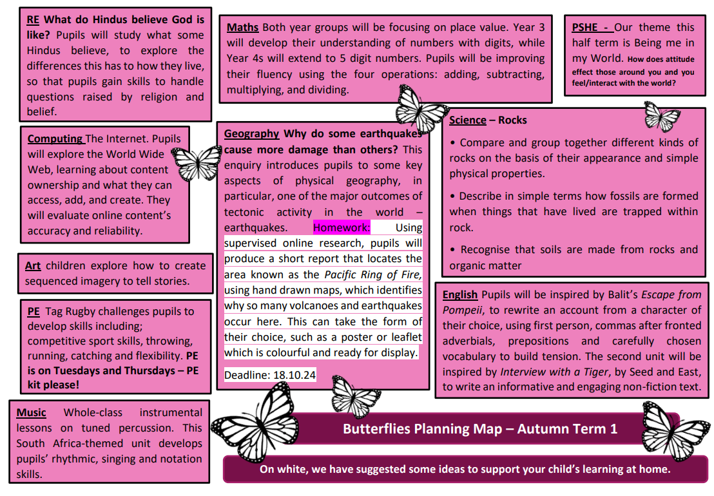

Slide 7
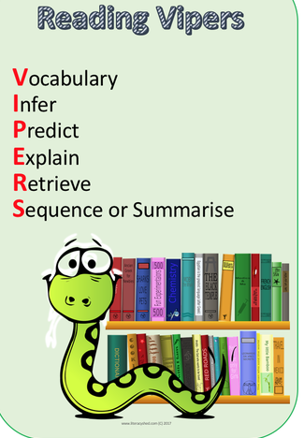
Reading at home
Your child will bring home books from school. Please read with your child and ask questions to check understanding.
We use VIPERS in school to help with understanding. I will print some example questions that you might use and send them home with your child soon.
The children visit the library every week. They choose books which are linked to their AR (Accelerated Reader) level or Bug Club level.
If your child has a set ‘Bug Club’ book. Please read and re-read this book with your child at home to build fluency. (This doesn’t mean that you shouldn’t read other books!)

Slide 8
Reading at school
Children at school will practise reading skills through Bug Club, guided reading sessions and English lessons.
Children on the Bug Club scheme will take home a book based on their sound knowledge and confidence.
Once the children have finished Bug Club phonics scheme, they will work through the brand new ‘reading for fluency’ bug club books. There is a range of colours, with the final colour being lime.
After this, reading will be assessed on Accelerated Reader and they will take home an AR book based on their reading age. The children independently quiz on these to test their comprehension and win raffle tickets for 100% results. These books may be a bit longer and the children are encouraged to change these independently. Please remind and encourage them.

Slide 9
Bug Club
Children are taught phonics, spelling and handwriting through the scheme.
Please read their assigned book with them and practise the words and sounds at the start of the book and the comprehension questions at the end.
Normally, 3 reads is the amount needed to show the necessary fluency (this may be more/less).
Please make sure children have their Bug Club book in school every day.

Slide 10
Home Learning
Read, read, read
They will have weekly spellings. These will be given out each week via Teams and on paper, practised in class and at home then tested the following week.
Handwriting/phonics support may be sent home to practise.
The topic map on the class page has some optional home learning.
Any extra home learning done that is linked to our topics will always be celebrated!

Slide 11
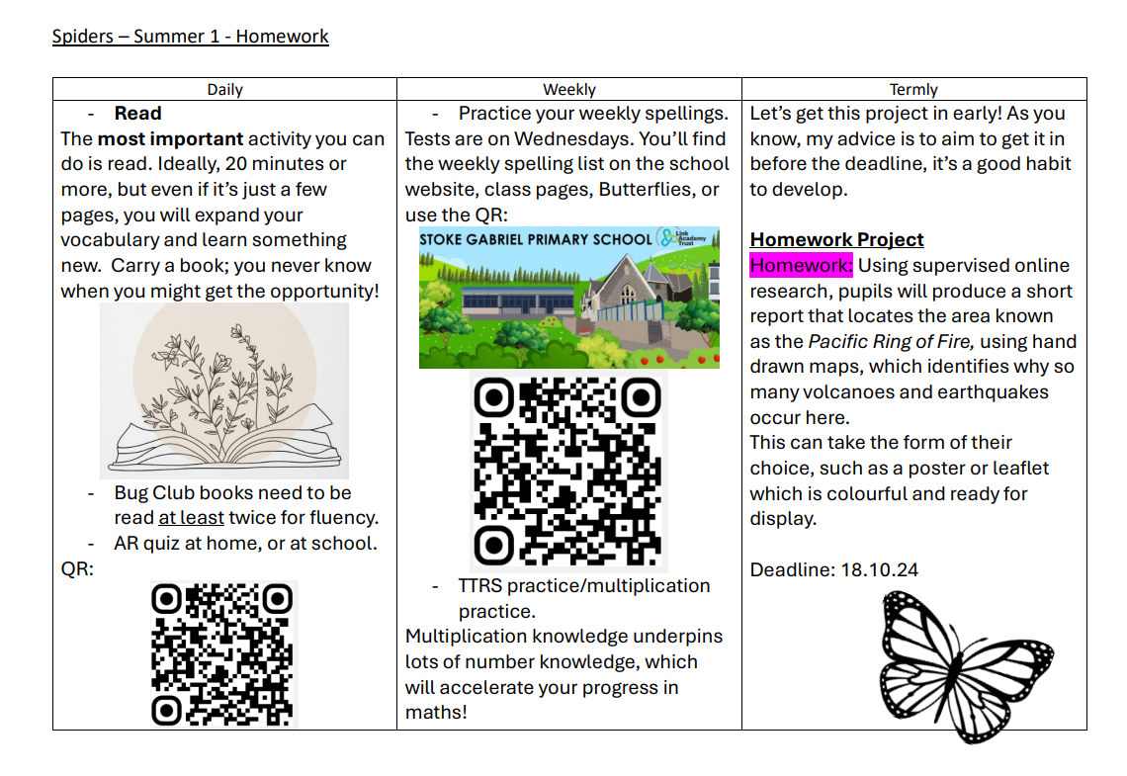

Slide 12
Maths
By then end of Year Three the children should know the 3, 4 and 8 times as well as the 2, 5 and 10 times tables learnt in KS1. By the end of Year Four they will be able to recite all times tables up to 12.
Have a look at the calculation policy on the school website to see the different stages of addition and subtraction.
This first half term we will be focusing on place value, with a later focus on the four operations.

Slide 13
P.E & Uniform
PE for Butterflies takes place on Tuesday and Thursday afternoons. Please make sure your child comes to school in their PE kit.
Children should avoid wearing earrings on PE days, or they need to be able to remove the earrings themselves or wear tape.
Long hair must be tied back, please ensure they have a hair band if necessary.
All uniform to be named.

Slide 14
Home time
You can enter the playground when the gate has been opened.
The children will be dismissed at 3.20pm.
We will not allow a child to go with another adult unless it has been previously arranged with us, or the office have been informed. If you have forgotten, the school will phone you to confirm.
If this is a regular arrangement, please let me know.
Please wait until your child has indicated that they have seen you.
Please no dogs on the playground.

Slide 15
Extra info
Prescribed medicines are only administered with parental consent. Forms at the office.
Please do not allow your child to bring in toys.
Please ensure all emergency contact details are up to date.
Year 4- Times Tables Check in June
Website and school FaceBook will be updated regularly.

Slide 16
Please come and talk to me
I’m available most days after school and can make an appointment with you to discuss any matters or concerns.
Similarly, I will contact you if we have any concerns or queries regarding your child.
Finally, if you’d like to help out at school, you are most welcome!
You must be cleared by DBS and wear a visitor badge in school - please contact the office for details.

Slide 17

Any questions?

