Slide 1

Welcome
SEND Coffee/Tea afternoon.
Wednesday 27th September 2023

Slide 2
Agenda…
What is SEND? What does SEND look like in Stoke Gabriel?
Who do I contact if I have a concern?
Equality Vs equity
What is our Local Offer?
Early Help offer.
Inclusion and Improvement Hub offer – SEMH courses.

Slide 3
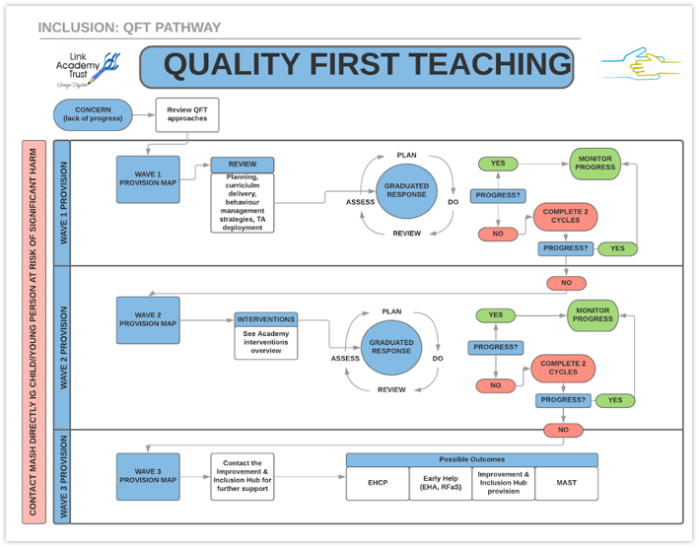
What is SEND and what does SEND look like in Stoke Gabriel?

Slide 4
Who do I contact if I have a concern?
Initially, your child’s class teacher. We are all teachers responsible for children with SEND.
Share further/growing concerns with your child’s class teacher and ask for your worries to be shared with the Special Needs & Disabilities Coordinator (SENDCo).

Slide 5

Equality Vs equity

Slide 6
What is our Local Offer?
Two main purposes:
To provide clear, comprehensive and accessible information about the support and opportunities that are available.
To make provision more responsive to local needs.

Slide 7
What is our Local Offer?
The Local Offer brings together information about education, health and care services, voluntary agencies, leisure activities and support groups in one place. It includes:
Education – support in early years, schools and college, including transport.
Health – specialist clinics, support and advice for children and young people with medical needs.
Social care – support for personal care and practical assistance, short breaks and personal budgets.
Transitions – moving between phases of education and preparing for adulthood.
Education, Health and Care Plans (EHCPs) – the statutory EHCP process explained, including applying for a plan, transfers and reviews.
Information, advice and support – where to get impartial and confidential information, advice and support.
ourses.

Slide 8
Early Help
A system that enables families to manage their own dilemmas and solve their own problems, making whatever changes are necessary to secure the well-being of their children.
- finance support - domestic violence
- health support - criminal activity
- mental health support - drugs and alcohol support
It is not the same service as Social Services.
The main aim is to prevent further problems in the future

Slide 9
Inclusion and Improvement Hub offer – SEMH courses.
Part of an offer to support children and families.
Supporting connection, big feelings, worries, struggles, changes in life – divorce, new home, death of a pet/family member.
Child does not need to have SEMH needs. Some children in attendance do, many do not.
Courses run throughout the year for different courses.
Inclusion and Improvement Hub (The Link) - SEMH Course Content

Slide 10
Inclusion and Improvement Hub offer – SEMH courses.
Feedback:
“The time I was able to spend with my son in this beautiful forest has genuinely been invaluable. It's a special course run by wonderful, caring people. I can't really describe enough the difference it has made. It's a space to be calm and bond and talk about some pretty difficult issues without them being the only thing that is focused on. It's a happy space and I'm very grateful that we had the opportunity."
void the actions that cause this 'flipping the lid."

Slide 11
Inclusion and Improvement Hub offer – SEMH courses.
Feedback:
"I think giving my son some one to one time and space has made him feel more heard and I have a better understanding of how I need to listen to what he is trying to tell me through his temper."
"He has started to listen more!"
"Reflecting on how I manage my own anxiety I can see now how it impacts my child."
void the actions that cause this 'flipping the lid."

Slide 12
Inclusion and Improvement Hub offer – SEMH courses.
Feedback:
"She came out of her shell on the course. She looked forward to the course each week. Better able to visualise positive outcomes. Growing in confidence when trying new things and meeting new people. Growing independence."

Slide 13
Helpful links
Early Help:
A one minute guide to Early Help in Devon - Devon Safeguarding Children Partnership (devonscp.org.uk)
Inclusion Hub:
Inclusion and Improvement Hub (The Link) - Home

Slide 14
Questions
I will be around for the remaining time to answer any questions or queries.
Thank you for attending.

